Slide 1

WEB Development
Grade 7&8

Slide 2
Recap of the last Class
Notes:
Objective:
Keep a healthy Discussion.
We learned about How to create Contact us form
Learned about how to create dropdown section menu
Learned about how to style webpages and make them responsive
Understood moreover input types and How to add leading icons

Slide 3
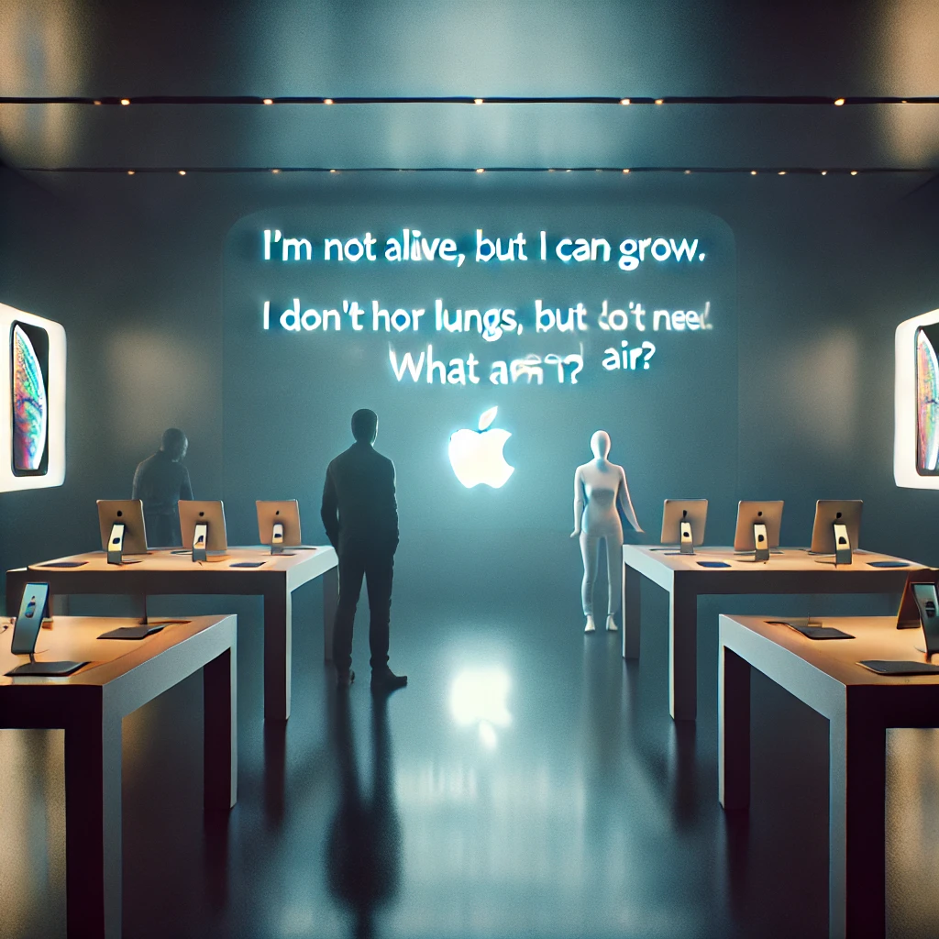
The Apple Store Riddle
At the Apple Store, all the devices suddenly froze. A riddle appeared on the main screen:
"Solve me to unlock the store!"
"I’m not alive, but I can grow. I don’t have lungs, but I need air. What am I?"
Can you help the manager solve it?
Notes:
Answer: Fire!

Slide 4
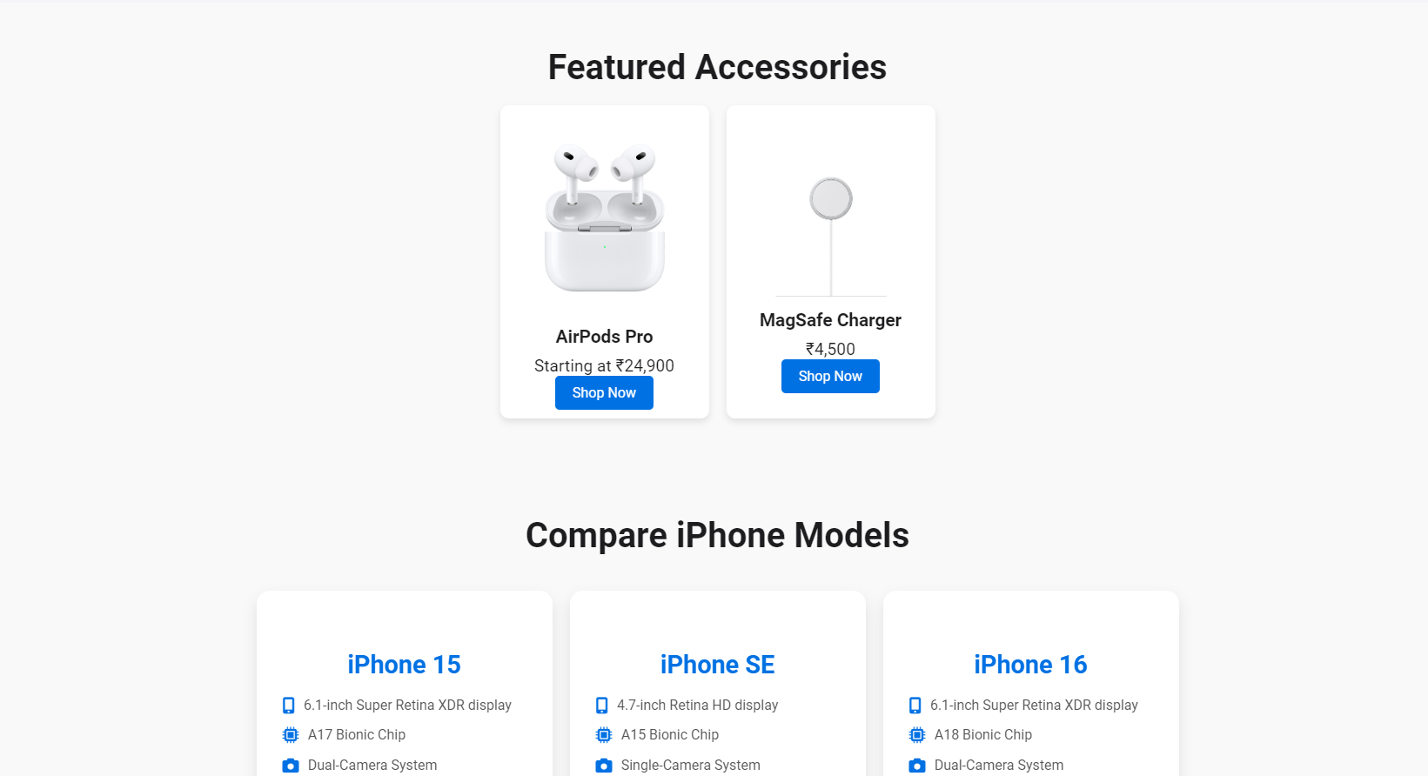
create a real-world online marketplace website
Notes:
Objective:
Introduce the concept of navigation bar and Hero section
Day 1: Objective
Objective:
Implement the hero section
Add a navigation bar to the header
Understand how to add icons.

Slide 5
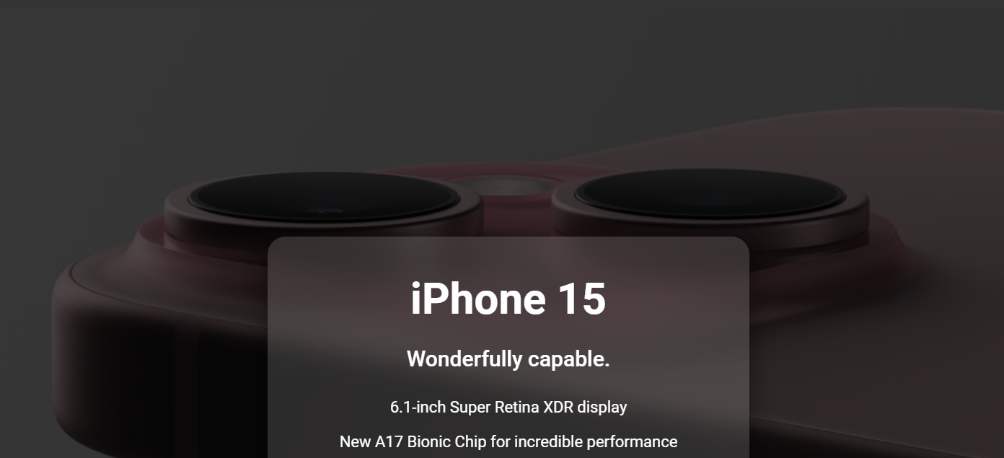
Project: Apple Clone
Notes:
Choose Level of Project Based on Student Capacity
Project Demo Link:
Basic Project Demo
Advance Project Demo
Project Code:
Basic: Apple Clone
Advance: Apple Clone
Objective:
Present the final project example.
Teacher Instructions:
Show the Screenshot:
Display the screenshot of the final project example.
Show the Project in Live Action:
Demonstrate the project on a live website to show how it functions.
Explain the Project:
Inform students that they will create a similar project.
Highlight the key features:
A responsive and user-friendly Webpage.
An engaging Hero Section.

Slide 6
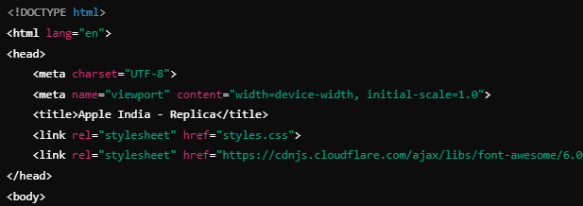
Html Boilerplate
Notes:
"Teacher's Activity"
Project Codebase:
Basic: Apple Clone
Advance: Apple Clone
Objective:
Understand how to setup basic boilerplate
**** Use Tr code's for recap for better explanation and for code completion use code base. ****
Teacher Instructions:
Display the screenshot of the HTML code.
Provide an overview of the section:
Code Explanation:
This part sets up the basic structure of the HTML document, links to a custom CSS file (styles.css) for styling, and imports the Font Awesome library for icons. It also includes the viewport meta tag to ensure the page is responsive on different devices.

Slide 7
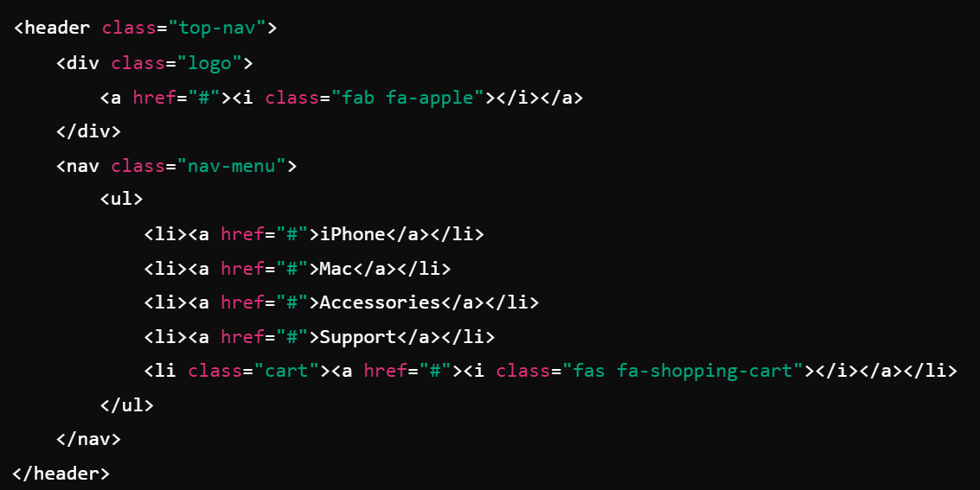
Header Navigation
Notes:
"Teacher's Activity"
Project Codebase:
Basic: Apple Clone
Advance: Apple Clone
Objective:
Understand how to create header and navigation bar
**** Use Tr code's for recap for better explanation and for code completion use code base. ****
Teacher Instructions:
Display the screenshot of the HTML code.
Provide an overview of the section:
Code Explanation:
This block creates the top navigation bar with links to various product categories such as iPhone, Mac, Accessories, and Support.
The <i> tag with Font Awesome classes (fab fa-apple, fas fa-shopping-cart) is used for displaying the Apple logo and shopping cart icon.

Slide 8
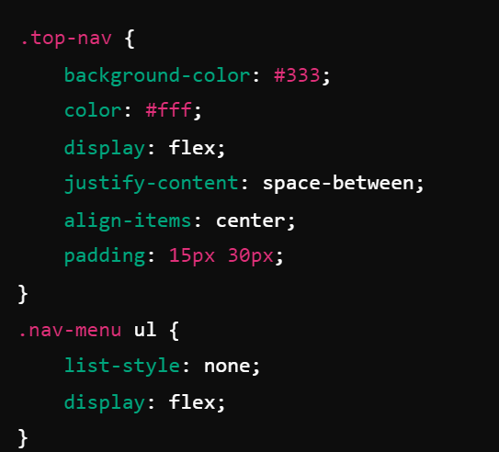
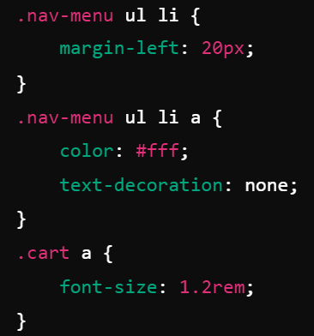
CSS Header Navigation
Notes:
"Teacher's Activity"
Project Codebase:
Basic: Apple Clone
Advance: Apple Clone
Objective:
Understand how to style header and navigation bar
**** Use Tr code's for recap for better explanation and for code completion use code base. ****
Teacher Instructions:
Display the screenshot of the CSS code.
Provide an overview of the section:
Code Explanation:
The flex display aligns the logo on one side and the menu on the other.
justify-content: space-between ensures the elements are evenly spaced, and align-items: center vertically aligns them.

Slide 9
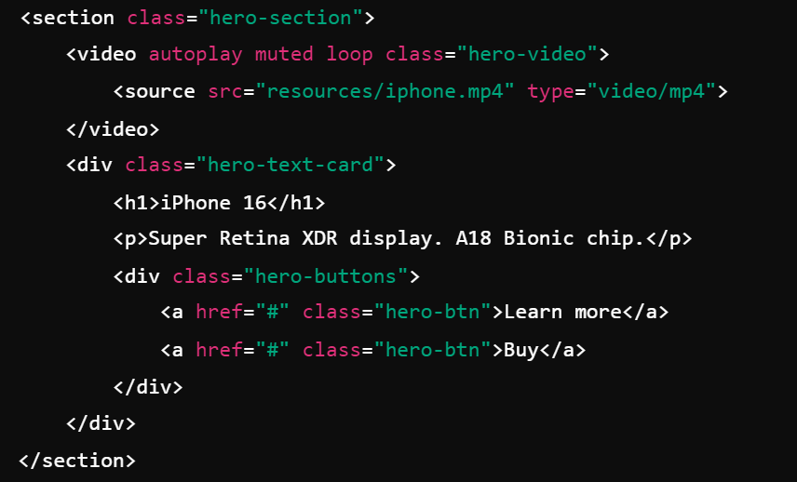
Hero Section
Notes:
"Teacher's Activity"
Project Codebase:
Basic: Apple Clone
Advance: Apple Clone
Objective:
Understand how to create Engaging hero section with background video playback
**** Use Tr code's for recap for better explanation and for code completion use code base. ****
Teacher Instructions:
Display the screenshot of the HTML code.
Provide an overview of the section:
Code Explanation:
This section contains a background video, showcasing the iPhone 16, with product information overlaid using a text card.
Two buttons are provided: one for more information and another to buy the product.

Slide 10
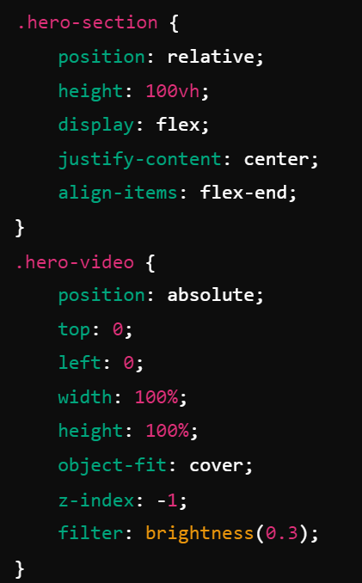
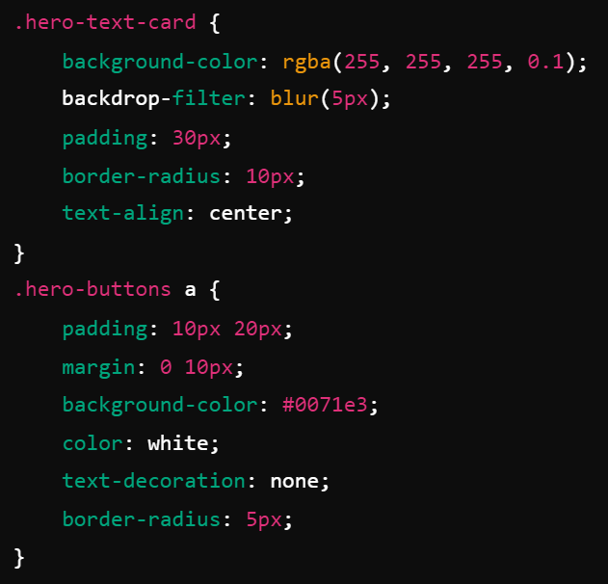
CSS Hero Section
Notes:
"Teacher's Activity"
Project Codebase:
Basic: Apple Clone
Advance: Apple Clone
Objective:
Understand how to add backdrop filter and understand flex layout
**** Use Tr code's for recap for better explanation and for code completion use code base. ****
Teacher Instructions:
Display the screenshot of the CSS code.
Provide an overview of the section:
Code Explanation:
The .hero-section uses flexbox to center the text card at the bottom of the screen.
The background video is positioned using absolute with a filter to darken it, ensuring the text is visible.

Slide 11
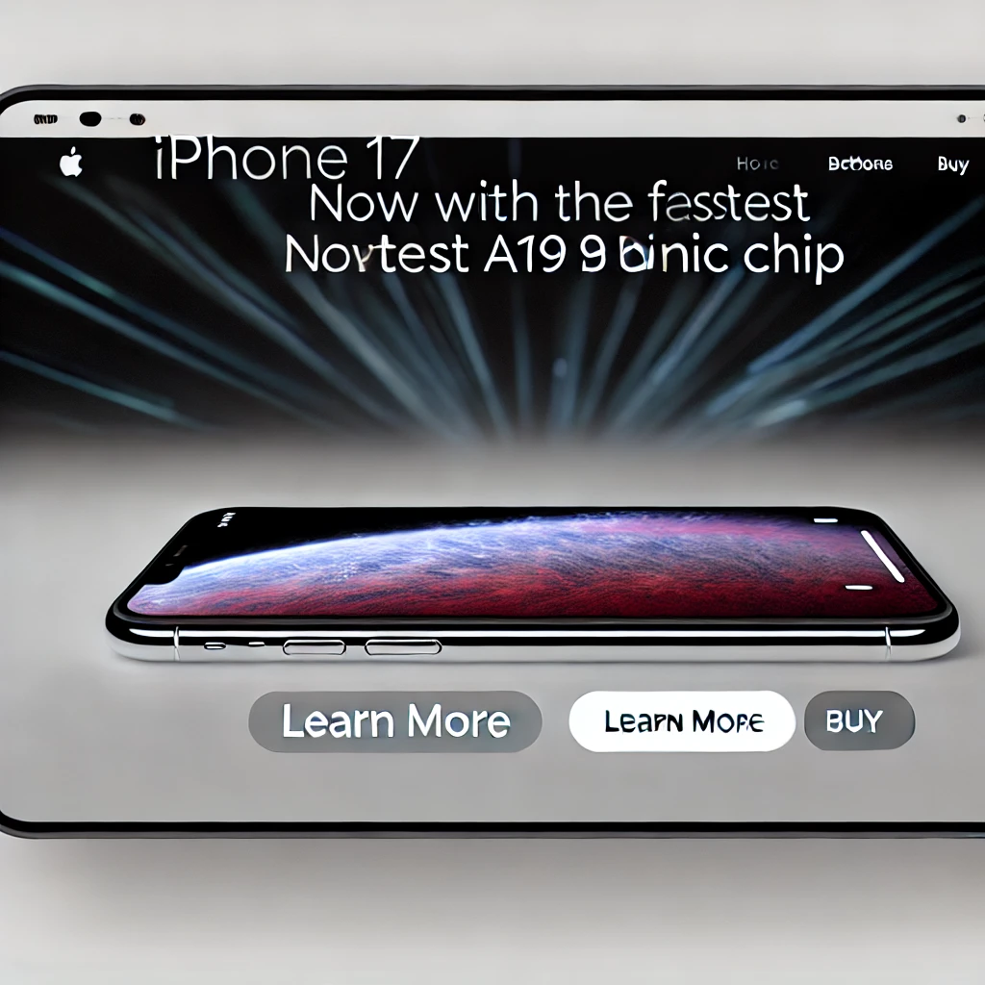
Now it's your turn!
Modify the text inside the hero section. Change the title from "iPhone 16" to "iPhone 17" and update the description to:
"Now with the fastest A19 Bionic chip."
Ensure that the buttons stay in place and the video background remains unchanged.
Notes:
"Students' Activity"
Objective:
This task helps students practice editing the content of an HTML structure without affecting other elements on the page.
Step-by-Step:
Instruct students to locate the <h1> and <p> tags within the hero section in the HTML file.
Guide them to update the title and description inside the respective tags:
Change <h1>iPhone 16</h1> to <h1>iPhone 17</h1>
Change the paragraph content inside <p> to reflect the new description:Super Retina XDR display. A18 Bionic chip. → Now with the fastest A19 Bionic chip.

Slide 12

Question: What is the purpose of the <i> tag in the navigation bar?
A) Add images
B) Display icons using Font Awesome
C) Link to other pages
D) Style the logo
Notes:
B) Display icons using Font Awesome

Slide 13
Question: Which CSS property helps align the logo and menu in the top navigation?
A) flex-direction
B) justify-content
C) align-items
D) margin
Notes:
B) justify-content

Slide 14
Question: What does the <video> element do in the hero section?
A) Adds an image
B) Adds background music
C) Plays a video background
D) Displays text
Notes:
C) Plays a video background

Slide 15
Question: What CSS property ensures the hero section video stays behind the text?
A) z-index
B) position
C) filter
D) flex
Notes:
A) z-index

Slide 16
Question: What is the purpose of backdrop-filter in the hero text card?
A) Blurs the background behind the text card
B) Changes the font color
C) Adds a shadow to the text
D) Moves the card to the top of the page
Notes:
A) Blurs the background behind the text card

Slide 17
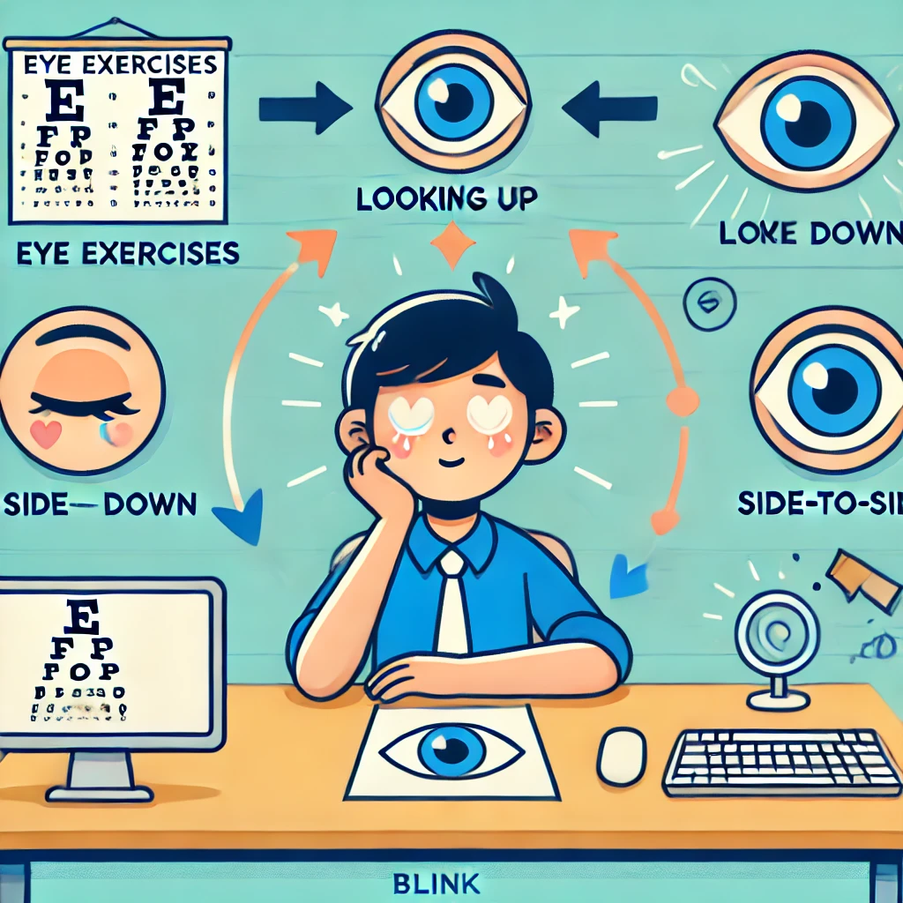
Eye Exercises
Notes:
Teacher Instruction : Explain importance of eye exercises
Why Eye Exercises Matter:
Staring at screens for long periods can strain your eyes.
Taking regular breaks keeps your eyes healthy and relaxed.
Simple Eye Exercises:
Look up and down: Slowly move your eyes up and down 5 times.
Side-to-side: Move your eyes from left to right 5 times.
Blinking: Blink quickly for 10 seconds to refresh your eyes.
Focus shift: Look at something far away for 20 seconds, then something close for 20 seconds.

Slide 18

Built the top navigation and hero section in HTML.
Used flexbox for layout alignment.
Added a video background to the hero section.
Styled text and buttons with CSS.
Ensured responsive design for different devices.
What have we learnt?
Notes:
Objective:
Summarize the key learnings from the lesson.
Teacher Instructions:
Instruct Student's to recap Today's Learning
Keep a healthy discussion engage student to a group discussion
Show a glimpse of what is awaiting to be reveal on the next class

Slide 19

Homework Discussion
Notes:
Instructions for the Teacher: Facilitate a discussion about the homework assignment.

Slide 20

Be careful when sharing personal information online.
Never share your passwords, home address, phone number, or personal details on websites, social media, or with strangers. Always ask a trusted adult if you're unsure about what information is safe to share.

